Slide 1


WATER FILTERING MECHANISM

Slide 2
Objective
Introduction
Filter Design
Future Improvements
Marketing
Conclusion
Q&A
CONTENT
2

Slide 3

THE OBJECTIVE
To contribute to the upliftment of the
underprivileged in Sri Lanka and support for
their well being
3

Slide 4


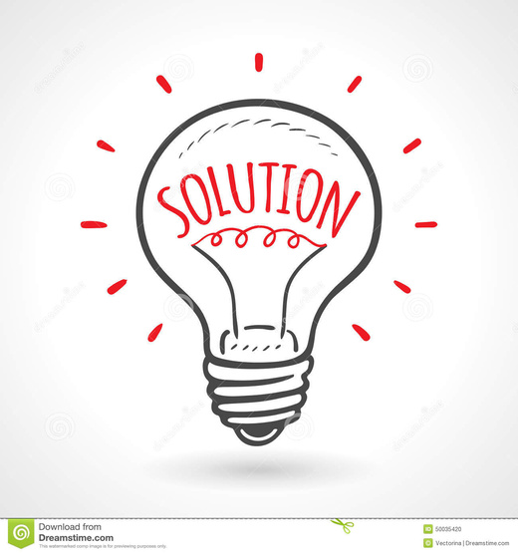
Scope
Uncovering solutions with modern technologies and knowledge for challenges in underprivileged people.
Problem
Introduction
Scarcity of suitable drinking water in Sri Lanka and diseases that occur.
Solution
The water filtering mechanism
4

Slide 5

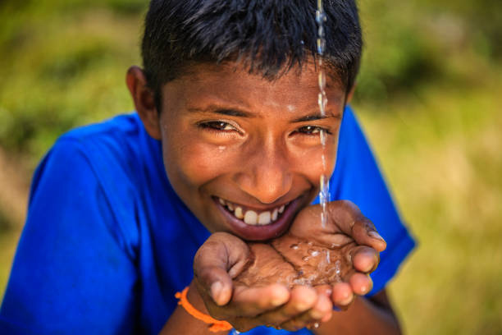
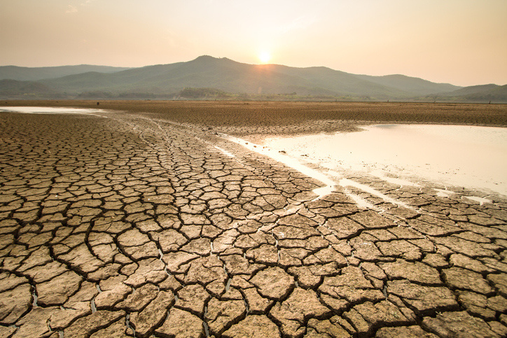
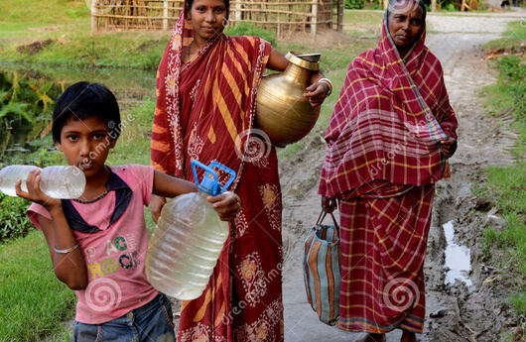
Problem
1.8 million people die from gastrointestinal illnesses including cholera (WHO).
Chronic kidney disease (CKD) is a major burden on the healthcare system of Sri Lanka.
Water-borne illnesses caused by contaminated water sources.
Anthropogenic activities in Sri Lanka.
Agricultural runoff in rural areas.
Poor quality of life and economic development.
5

Slide 6
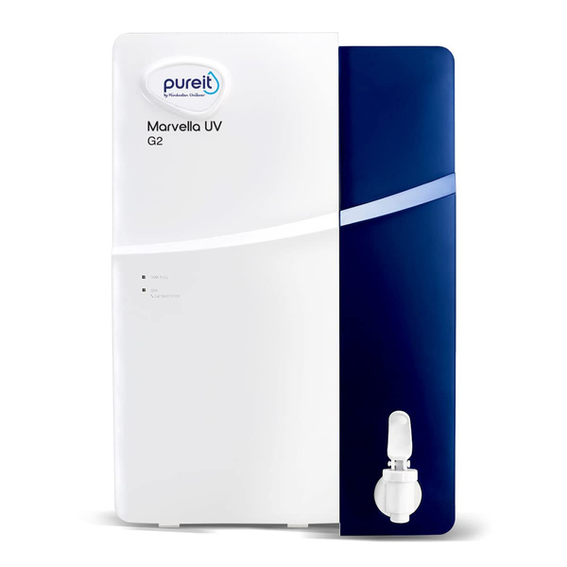
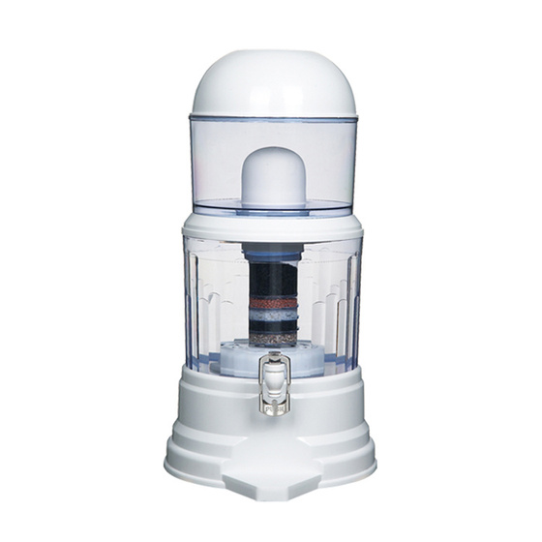
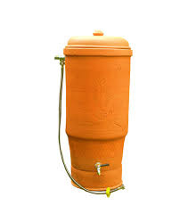
Existing Alternatives
60,0000/=
18,000/=
20,000/=
How our filter differ from already existing alternatives?
6

Slide 7
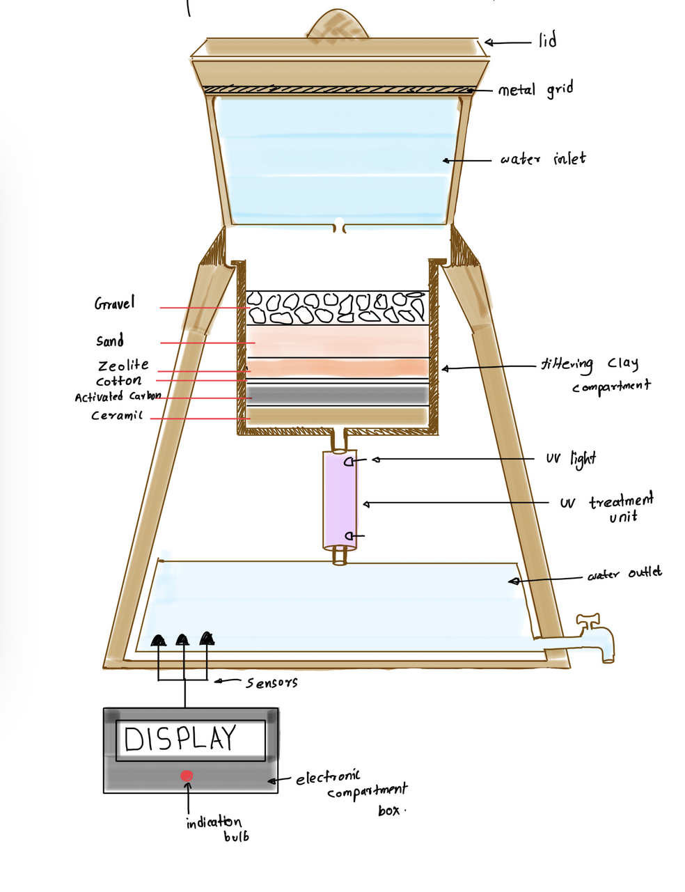
Solution
Our goal is to make the most practical and economical solution to make the filtering mechanism.
It is constructed from organic components.
There is no way to tell if the water is contaminated
Our filter is capable of water quality testing.
To monitor the parameters, different sensors are used.
7

Slide 8
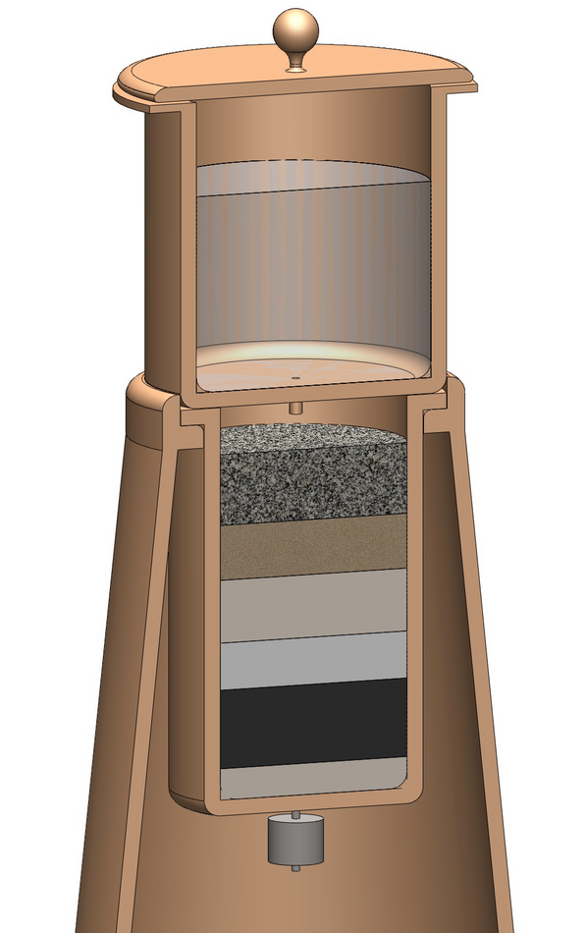

Filter Design
Active Carbon
Absorbent of impurities
Effective at removing organic compounds
Ceramic
Combination of clay and saw dust
Sand
Traps bacteria
Gravel
Prevent the water displacing the sand
8

Slide 9
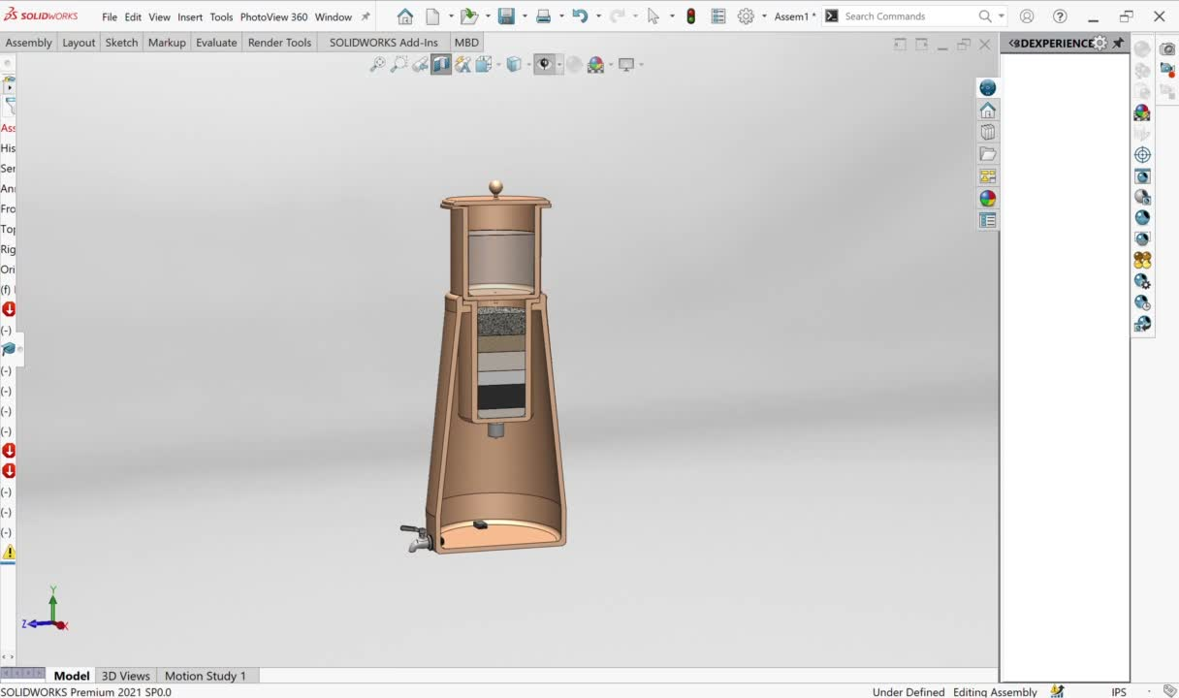
3D animation of the Filter Design
9

Slide 10
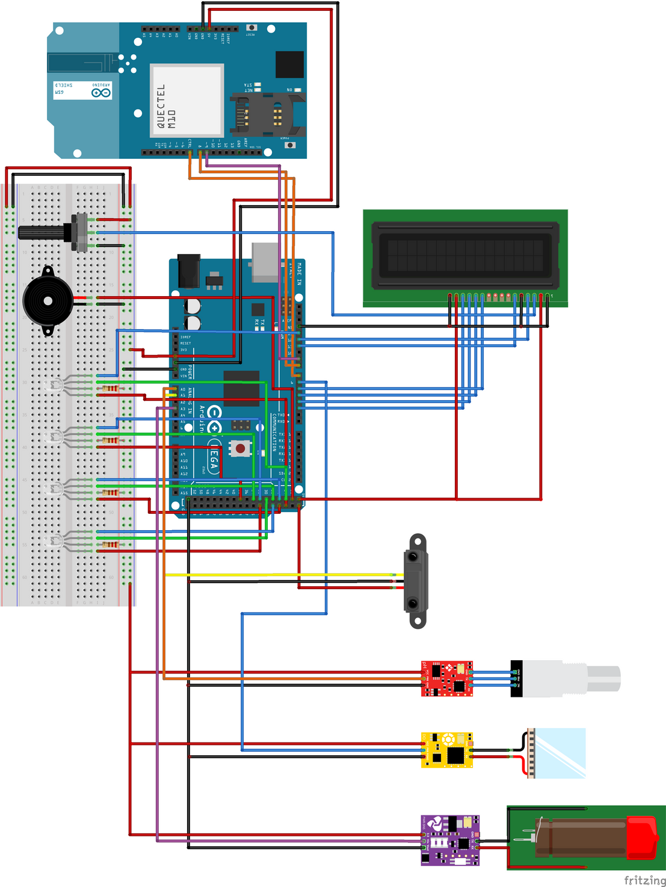

Filter Design Stage 2
Components used,
Arduino (mega) Board
GSM Shield
Temperature and PH Sensor
Ultrasonic Sensor
Turbidity Sensor
Buzzer
LED's
LCD Display
Sensors
10

Slide 11
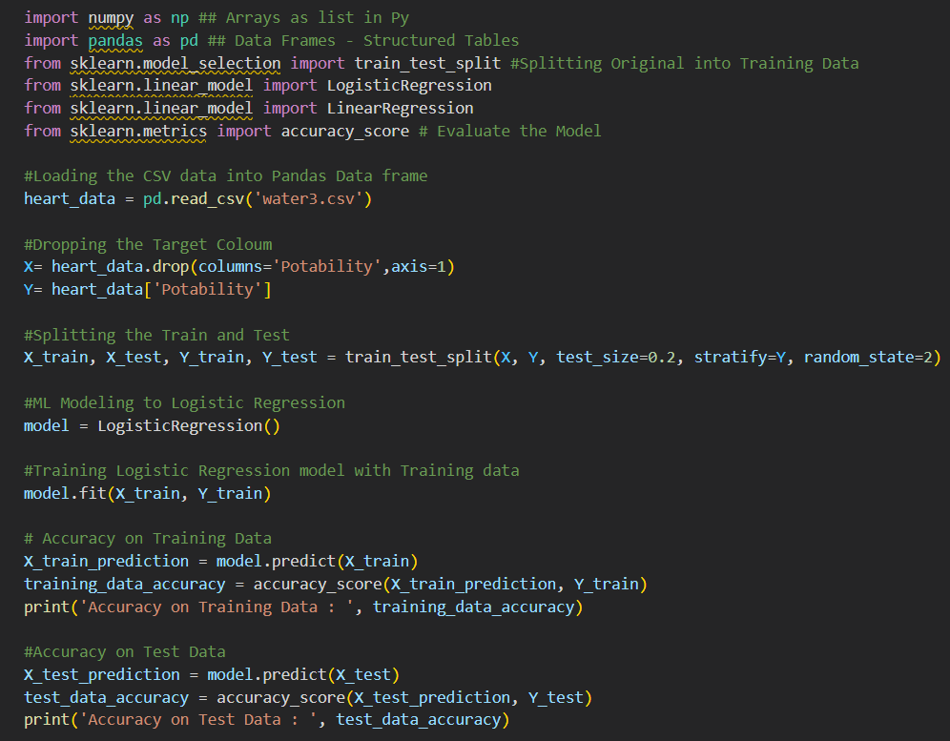
Machine Learning
Algorithm
11

Slide 12
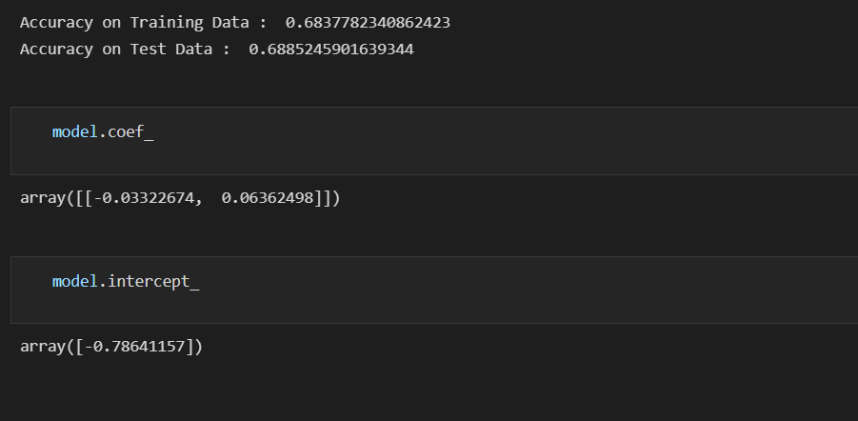
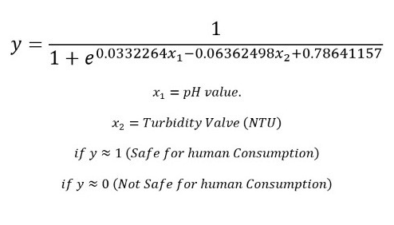
Results
12

Slide 13

Marketing Plan
A Non Profit Organization Rebooters (pvt) Ltd
Export Plan to Earn $
Fund Raising Projects Colab with WHO, UNISEF
Underpriviaged unemployment to employement
Product Freely given for underprivileged
13

Slide 14
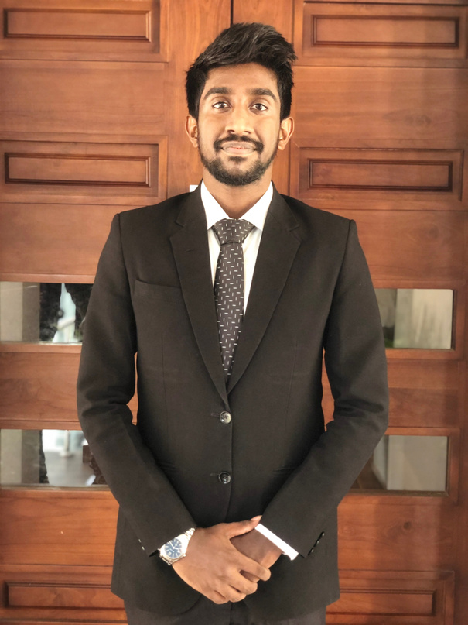
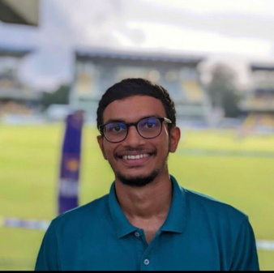
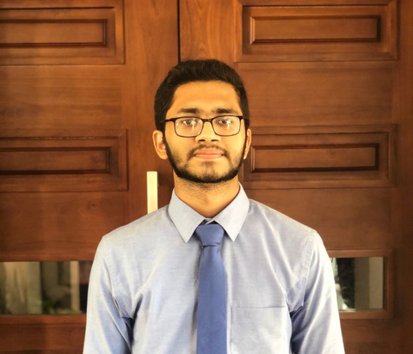
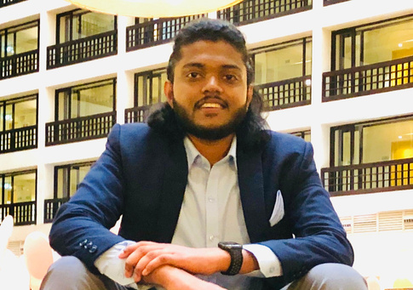
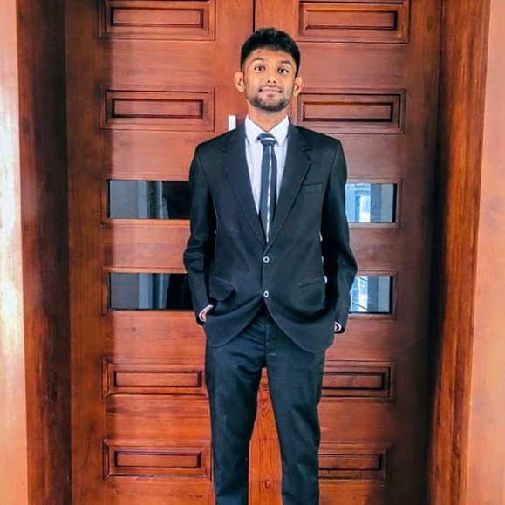
Thank You
Nimshan Isuranga
Gavishka Senanayake
Dhanuka Sankalpa
Ravindu Hasarinda
Haritha Chamath
14

Slide 15

References
Potterswithoutborders.com. 2022. [online] Available at: <http://potterswithoutborders.com/wp-content/uploads/2012/08/12.pdf> [Accessed 6 October 2022].
Clark, P., Pinedo, C., Fadus, M. and Capuzzi, S., 2022. Slow-sand water filter: Design, implementation, accessibility and sustainability in developing countries.
Lee, A., Elam, J. and Darling, S., 2022. Membrane materials for water purification: design, development, and application.
Jestec.taylors.edu.my. 2022. [online] Available at: <https://jestec.taylors.edu.my/Vol%205%20Issue%202%20June%2010/Vol_5(2)_165_175_MOHANAD%20EL-HARBAWI.pdf> [Accessed 6 October 2022].
2022. [online] Available at: <https://www.researchgate.net/publication/326684963_Ceramic_Water_Filters_A_Point-of-Use_Water_Treatment_Technology_to_Remove_Bacteria_from_Drinking_Water_in_Longhai_City_Fujian_Province_China> [Accessed 6 October 2022].
15

